Slide 1
Portable and Performant GPU/Heterogeneous Asynchronous Many-Task Runtime System
Ph.D. Research Proposal Brad Peterson

Slide 2
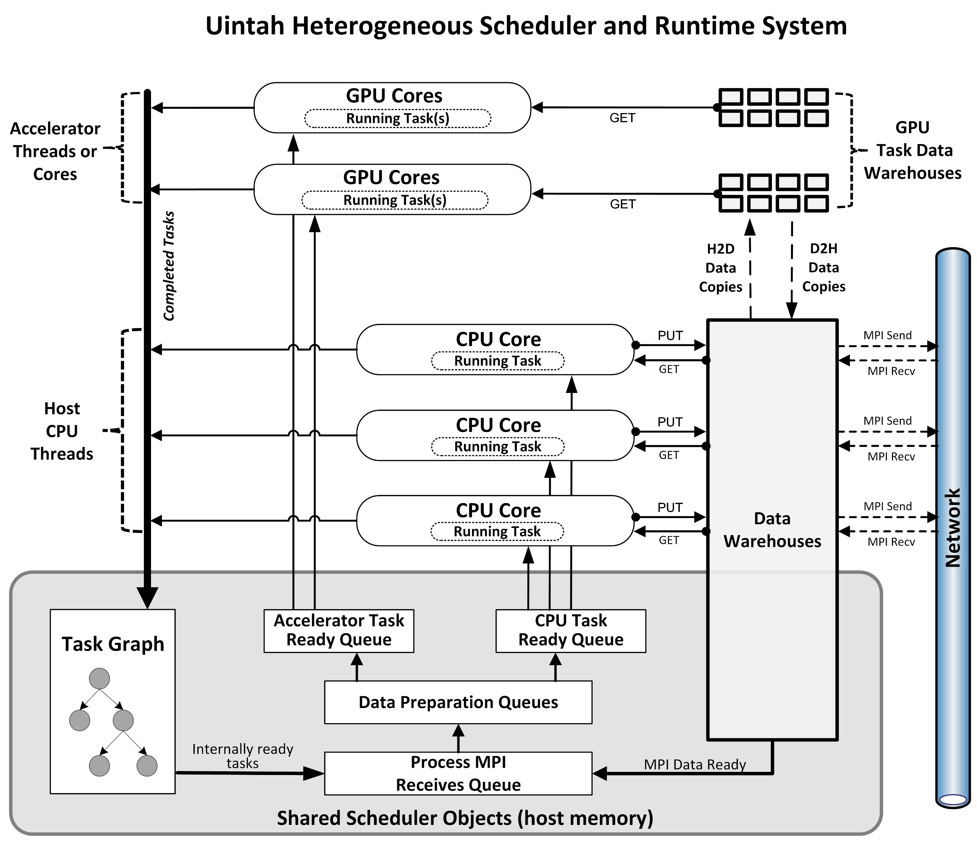
Uintah Overview
Asynchronous many-task (AMT) runtime
Emphasis on aiding application developers
Provides data stores for simulation variables
Automates halo gathering, data movement for GPUs, task graph creation, and task execution.
Uintah reaches full machine scale on current HPC machines
Titan with 256K cores and Mira with 768K cores

Slide 3
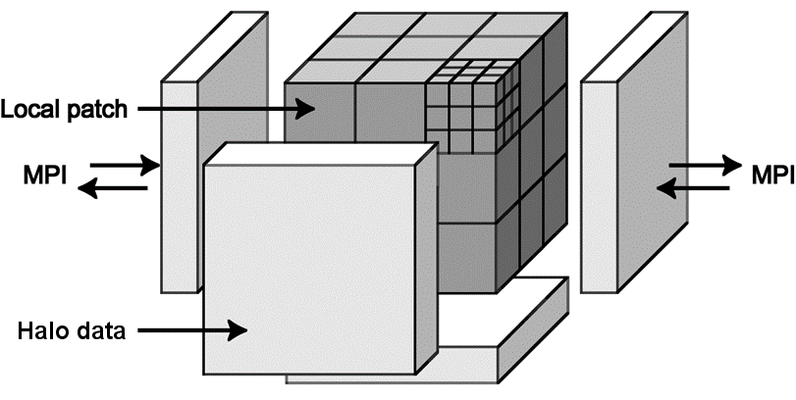
Uintah Overview - Continued
Structured mesh grid partitioned into uniform patches
Patch contains many cells
Tasks/variables assigned to patches
One node is assigned many patches
One MPI rank per node
Halo exchange with MPI rank neighbor
All CPU threads involved in scheduling and execution
Patch structure within one MPI rank
Notes:
Above image shows 27 patches in a node.
Within a patch could be individual cells. Common sizes of an individual patch are 16x16x16 or 32x32x32.
Give an example. Suppose we had 12,000 nodes, and 16 logical GPU cores on each node. At one patch per core, that allows for 192,000 patches. At 32^3 per patch, 6291456000 cells, that's roughly 1800x1800x1800 simulation.
Uintah operates on fixed timesteps. At the beginning of a time step, Uintah's runtime engine sends out all ghost cells to neighbor MPI ranks. It is then constantly processing any incoming ghost cells.

Slide 4
Uintah Tasks
Show CPU and GPU example

Slide 5
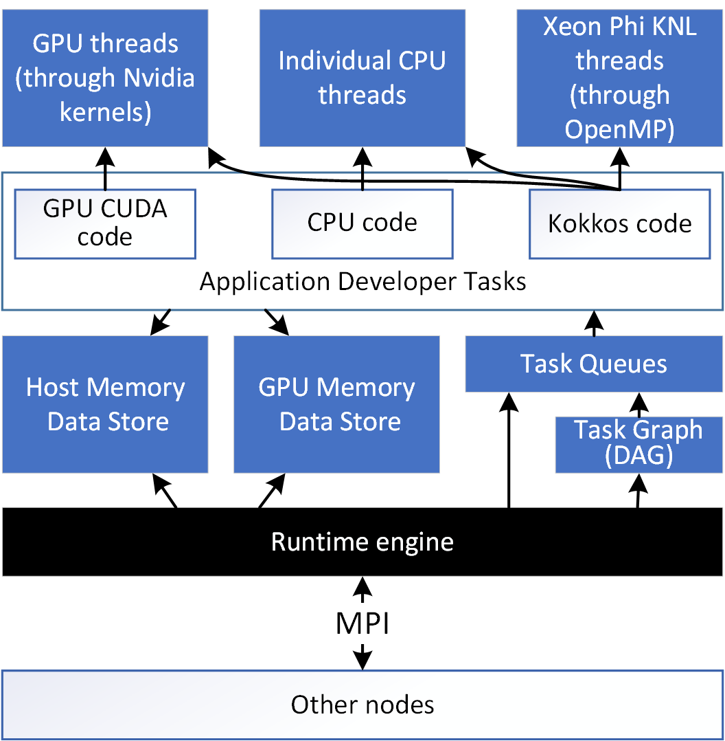
High-Level Goal
A performant and portable runtime model which:
Allows application developers to write code once (using Kokkos).
Executes portable code efficiently on GPUs and CPUs (and eventually Xeon Phis).
Supports a heterogenous mixture of tasks (even non-portable tasks).
Maintains separation of runtime and application development layer
Simplified Uintah Layout

Slide 6
Novelty of This Work – Comparison With Other Runtimes
Runtime | Common Usage | Developer involvement with runtime | Automatic internodal data movement | Automatic halo gathering | Runtime data store | Automatic data sharing among tasks | GPU support | Portable code for CPU and GPU tasks
Uintah | Multiphysics - adaptive mesh grid | Light | Yes – local memory/MPI | Host mem. (This work for GPU) | Host mem. (This work for GPU) | This work | Yes (This work for performance) | This work
Charm++ | Generalized tool / Load balancing | Medium | Invoked by user | No | No | No | With add-ons | Weak (add-ons required)
Legion | Generalized tool | Heavy | Yes – global memory | Yes (requires extensive definitions) | No | Yes | Yes | No
HPX | Generalized tool / Standards based design | Medium | Yes – global memory | No | No | No | No | No
PaRSEC | Linear Algebra | Medium | Yes | Yes | No | Yes | Yes | No
StarPU | Linear Algebra | Medium | No | No | No | Yes | Yes | No

Slide 7
Novelty of This Work – Comparison of Portability Tools
Tool | Portability approach | Data Variable Portability | Performance | Weaknesses | Portability Tools For Application Developers
Kokkos | Functors and templates | Extensive! Layout, dimensioning, tiling, subviews | Avoids indirection. Loops and layout can match architecture. | GPU is bulk synchronous (This work fixes that) | Random number generation, vectors, unordered maps, etc.
RAJA | Functors and templates | In development with CHAI, Sidr, and Umpire | Avoids indirection | Less mature than Kokkos, many more non-portable hacks. Synchronization on GPU reductions. | None
OpenACC | Compiler and pragmas | Basic | Compiler optimization. Forces simpler Fortran-like design. | No strong Xeon Phi KNL support. Pragma bloat. Synchronization on GPU reductions. | None
OpenMP | Compiler and pragmas | Basic | Compiler optimization. Forces simpler Fortran-like design. | GPU options and performance limited. Pragma bloat. | None
Open CL | CUDA-like syntax and compiler | Basic | Large performance penalty frequently observed. | Performance and uncertain future. | User libraries?

Slide 8

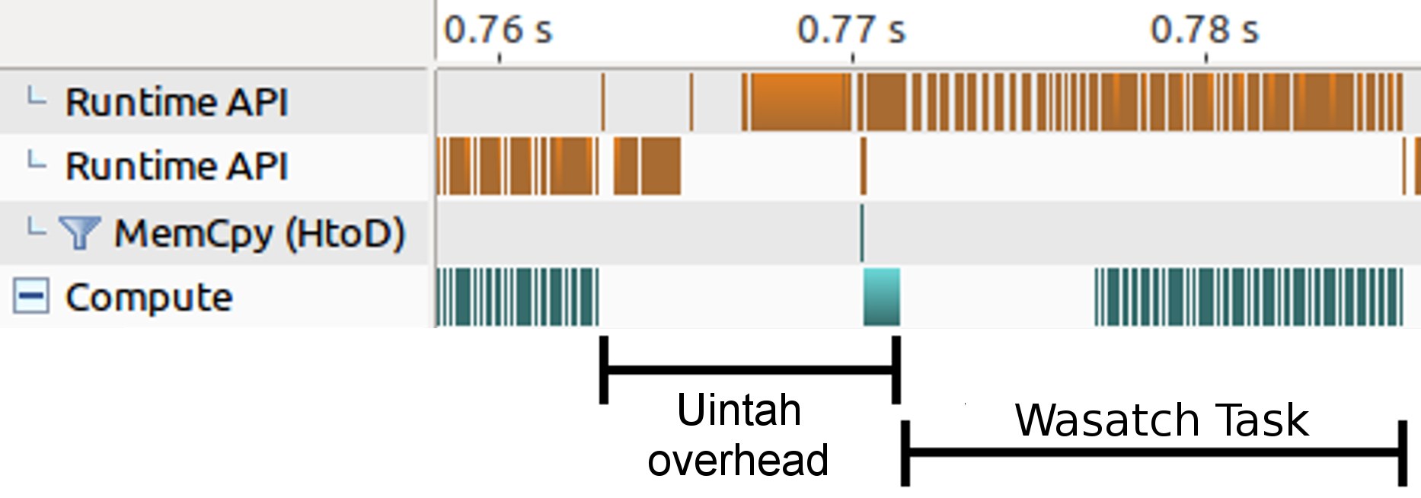
Before My Research: Prior Uintah GPU runtime
Synchronized memory copies
Proof of concept
Bulk synchronous
Runtime simulation variable management:
All halo gathers occur in host memory
Allocate and copy all simulation variables into GPU memory
Copy large, monolithic GPU Data Store host-to-device
Copy all computed data from GPU into host memory
Duplicated codebases (CPU and CUDA) common.
GPU tasks had to be manually configured and launched inside a CPU task
Serialized and synchronized execution of GPU tasks
Data store copies added to large overhead for short-lived tasks

Slide 9
Publications

Slide 10
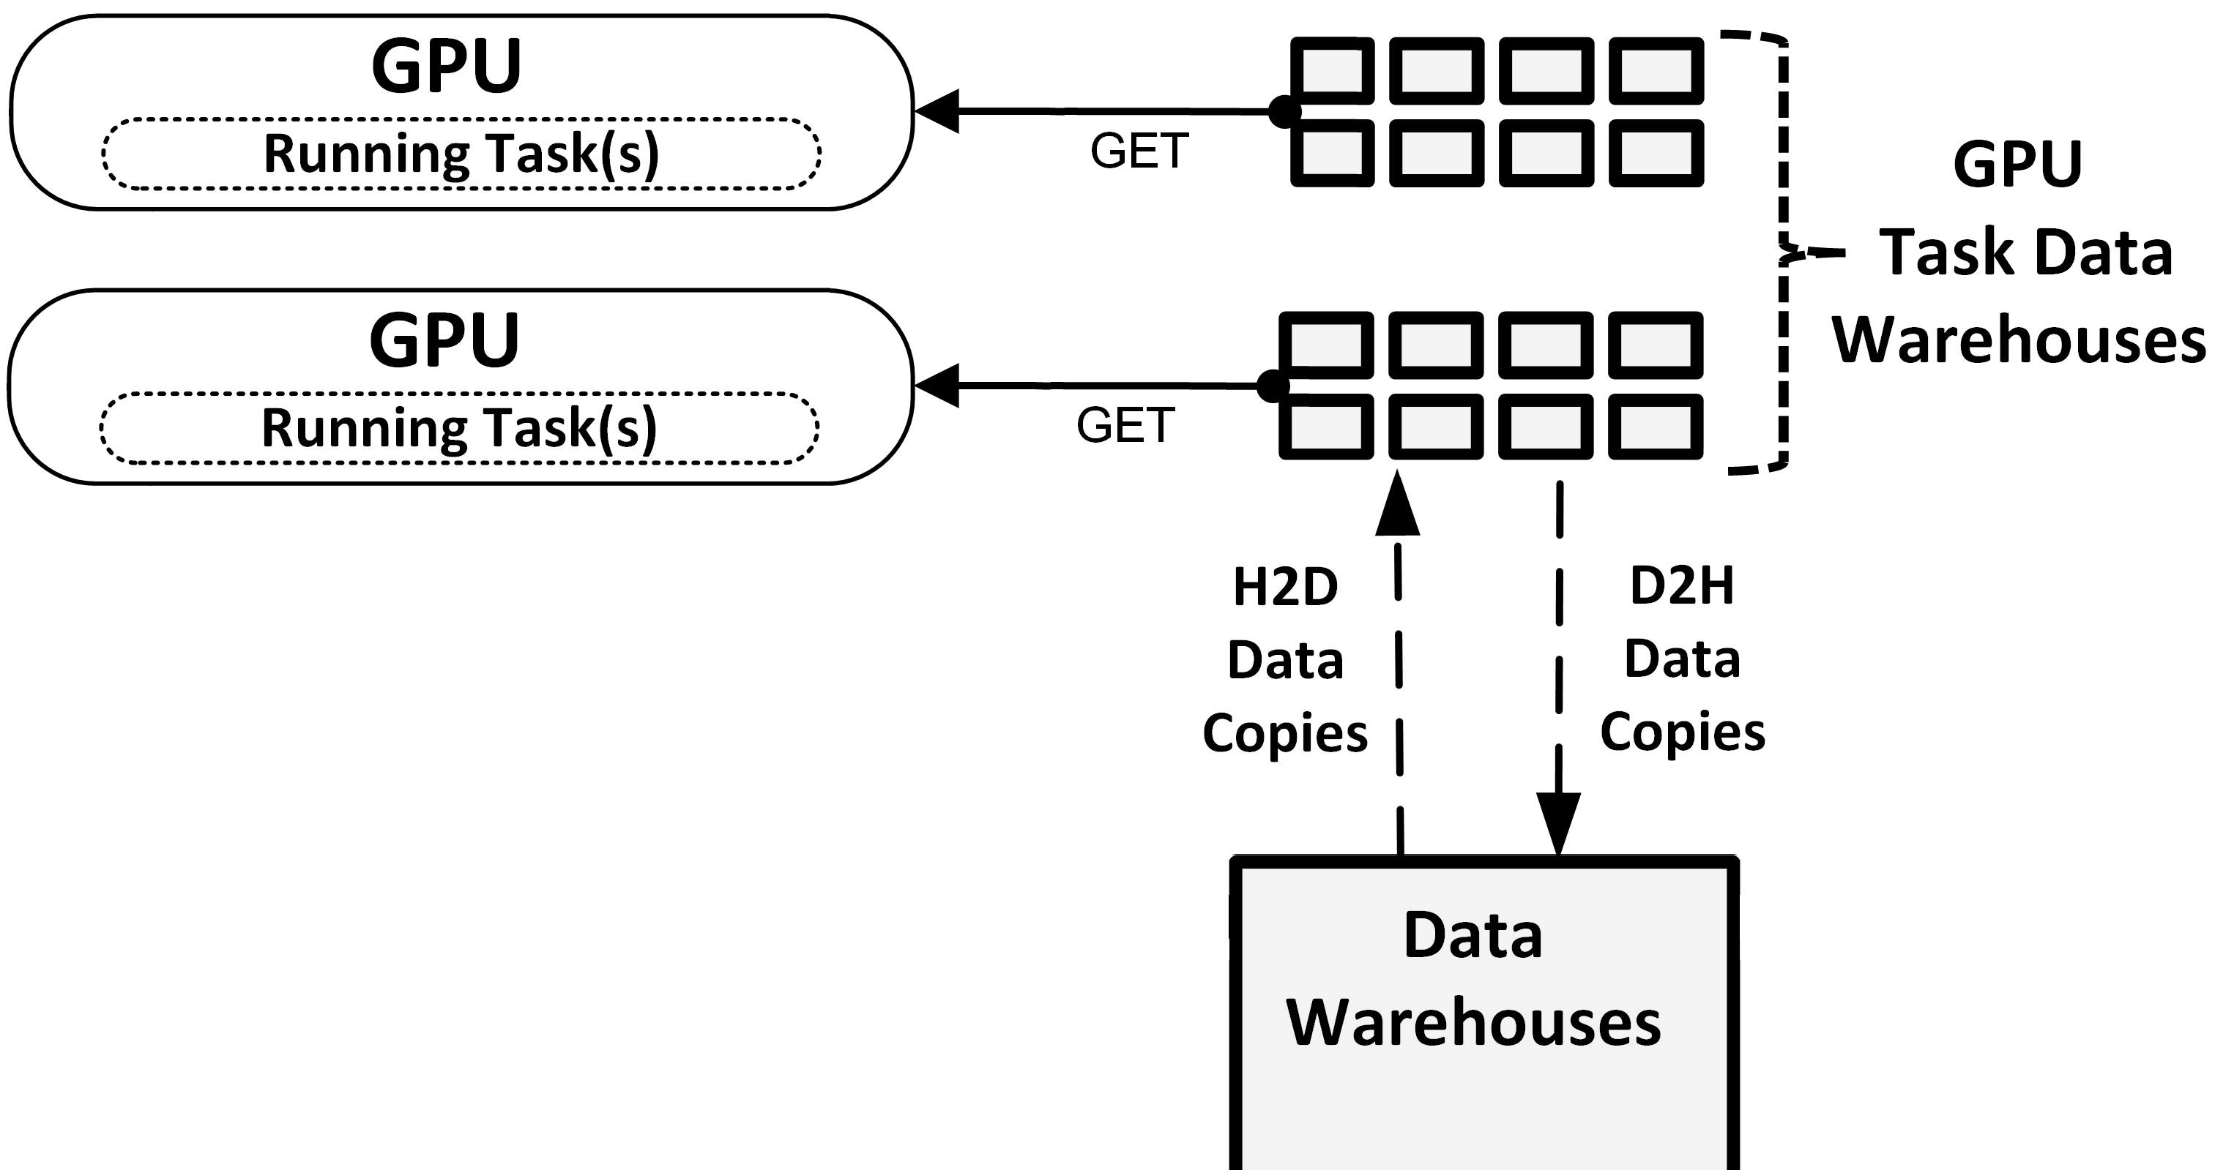
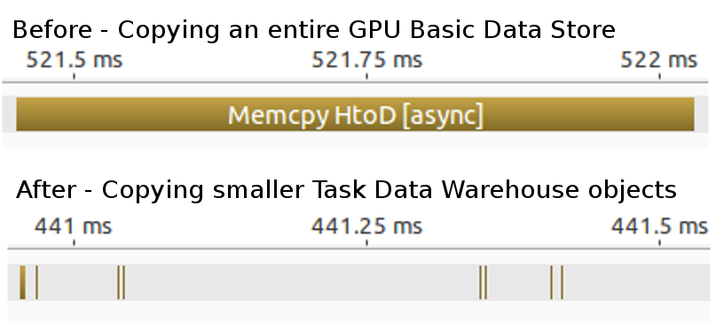
Task GPU Data Warehouse
Problem: Monolithic and shared GPU Data Store bad for asynchrony, concurrency, and copy overhead.
Solution: Now each GPU task receives its own data warehouse.
Much smaller (see figure on right)
Avoids concurrency entirely and great for asynchrony.
Programmability benefit: application developers can only access simulation variables they indicated they would.

Slide 11
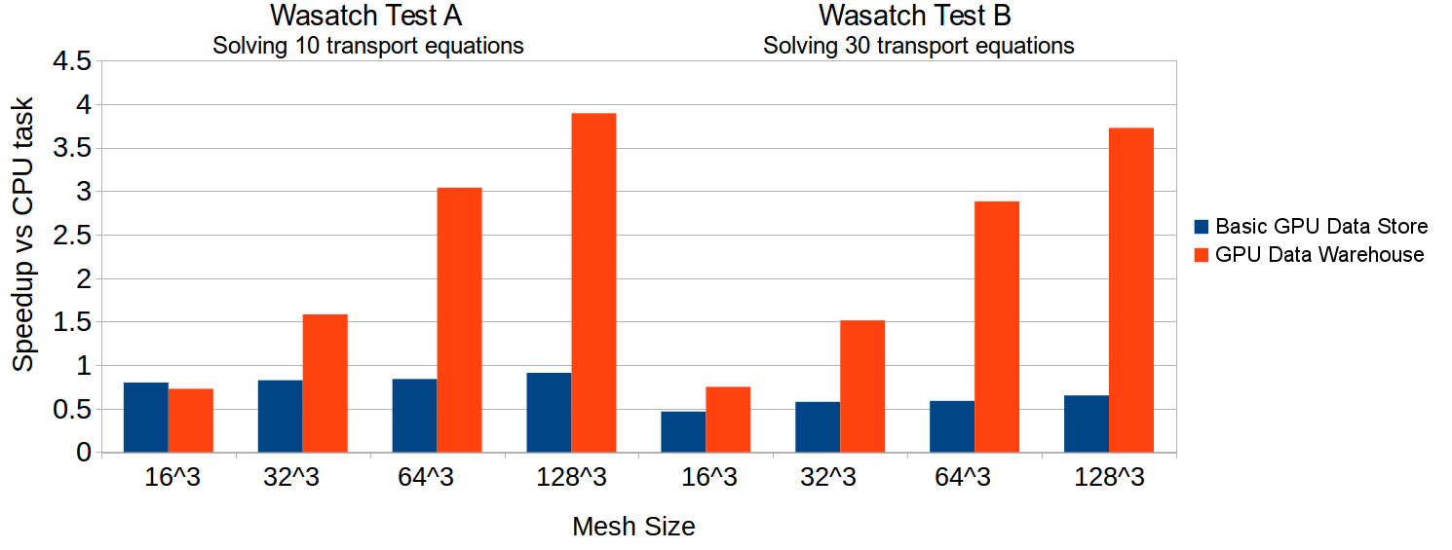
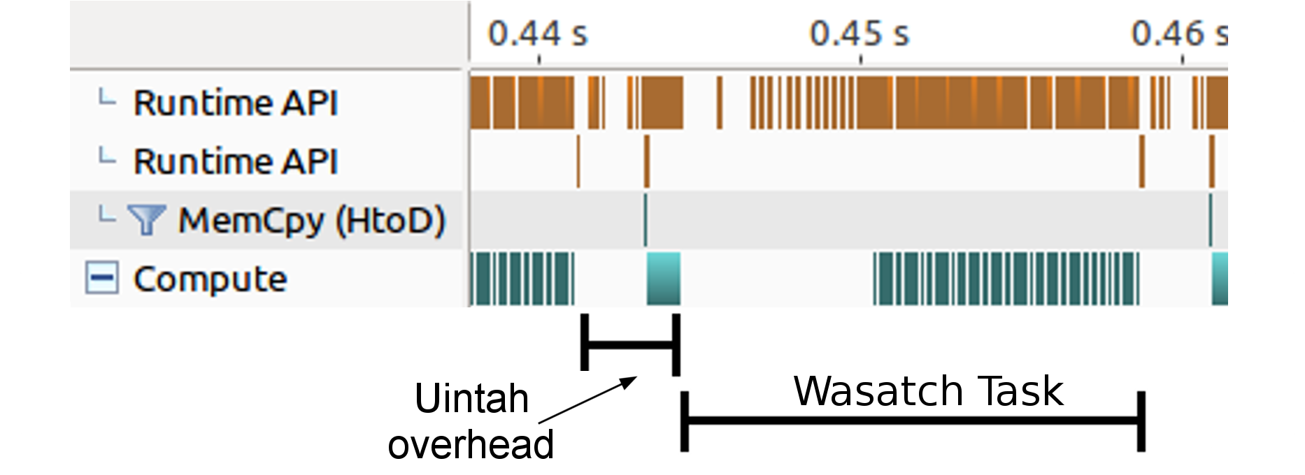
Tasks Dictate Data Persistence
Task scheduler keeps simulation variables in GPU memory as long as possible (avoids frequent host-to-GPU and GPU-to-host transfers)
Halo gathers occur within GPU memory if possible.
Before:
After:
Wasatch tasks solving 10 and 30 transport PDEs respectively. Computations performed on a Nvidia GTX 680 GPU and an Intel Xeon E5-2620.
Notes:
Dynamic task graph ready

Slide 12
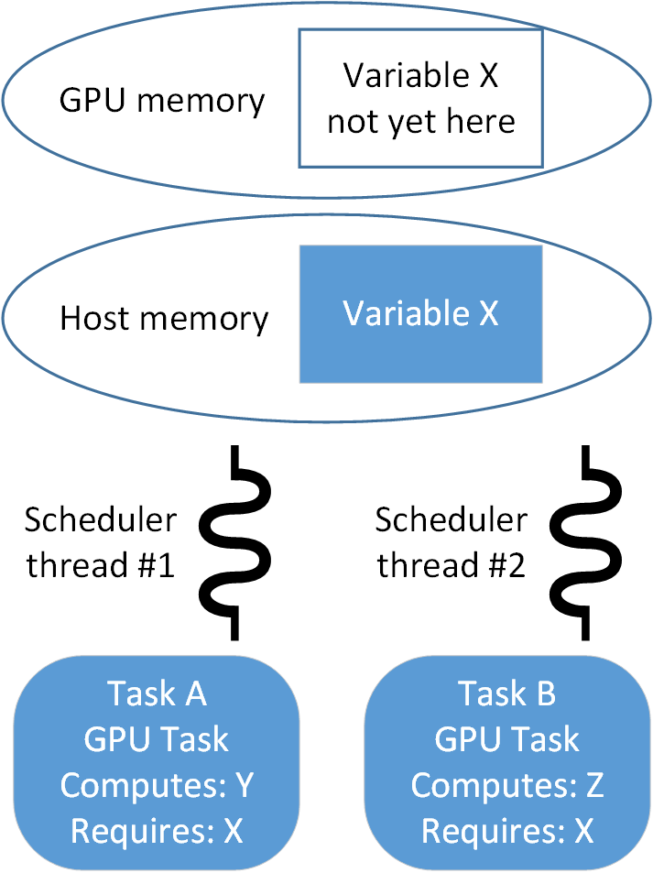
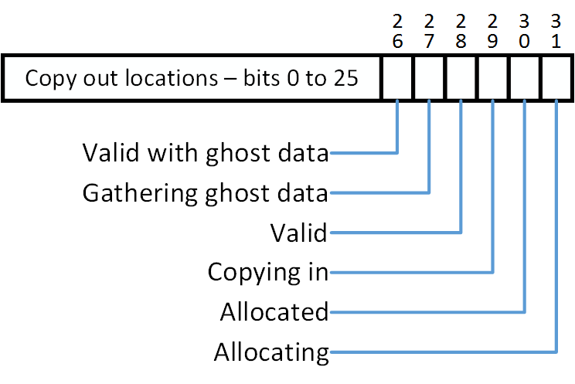
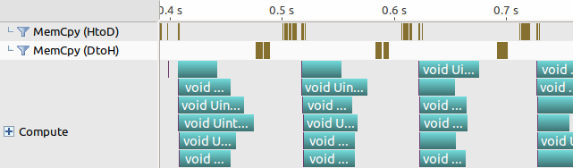
Data Sharing Among Tasks
Problem: Two scheduler threads are assigned a different task to analyze. Each requires X in GPU memory, but it is not yet there.
Status bitset assigned for each simulation variable. Allows scheduler threads to coordinate using atomic operations.
This was the last synchronization piece. Now kernels can overlap in the GPU!
Solution: Task scheduler threads now coordinate with one another. Above example: X is only copied once into GPU, and both tasks share it.
Notes:
Other schedulers use something similar to a cache coherency protocol. That requires a “snooping” approach.

Slide 13
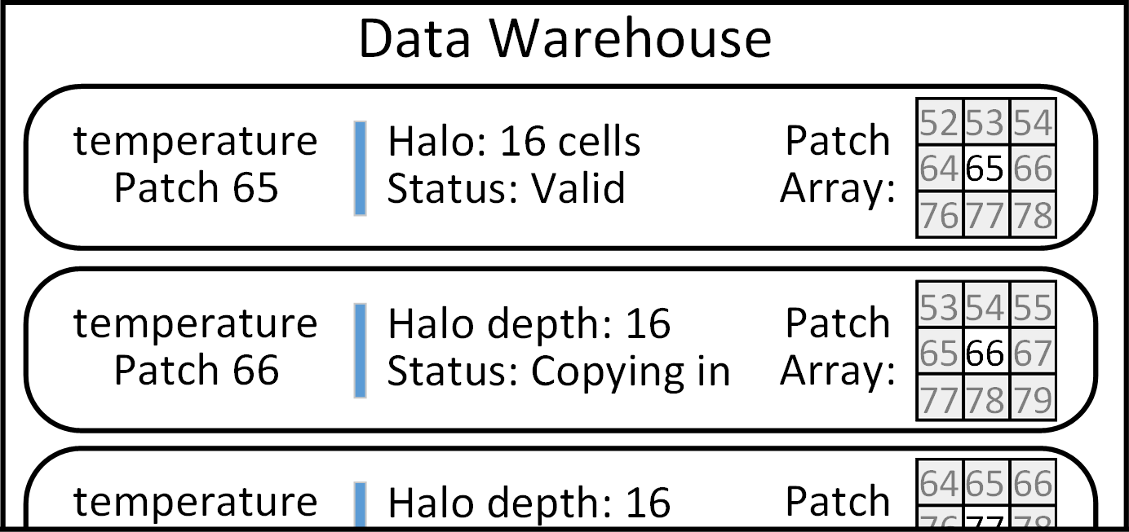
Data Sharing Among Data Dependencies
Recent Titan production run of a propose high efficiency coal boiler had global data dependencies.
Problem: Prior work could share a simulation variable among tasks, but not its halo data.
Duplication of data prevented problem fitting within GPU memory!
For example: Patch 66 duplicated three times

Slide 14
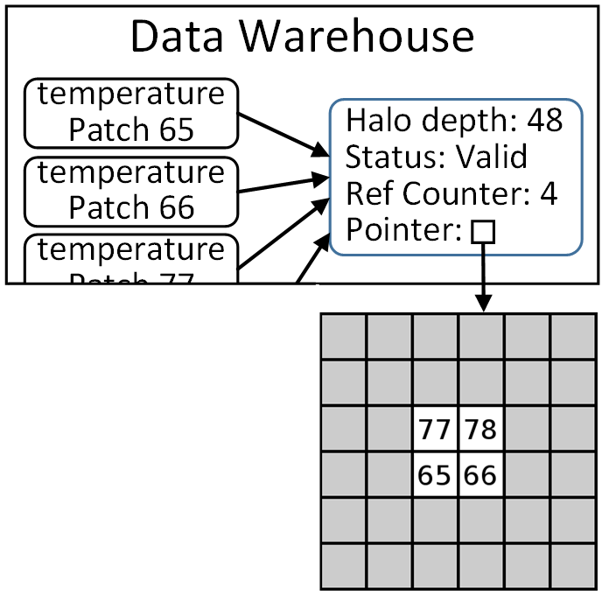
Data Sharing Among Data Dependencies
Task scheduler and data warehouse changes facilitated a halo sharing mechanism.
Dynamic and retains asynchrony.
Production problem fit into GPU memory!
Memory Overhead Improvements
Simulation Patch Layout | Host memory usage before (MB) | Host memory usage after (MB)
Coarse: 32³ cells, 4³ patches Fine: 64³ cells, 4³ patches | 3073 | 65
Coarse: 32³ cells, 4³ patches Fine: 128³ cells, 4³ patches | 23229 | 279
Coarse: 64³ cells, 4³ patches Fine: 128³ cells, 4³ patches | Exceeded memory | 311
Example follow-up: Patch 66 isn’t duplicated!
Memory usage for a production problem for computing radiative heat transfer.

Slide 15
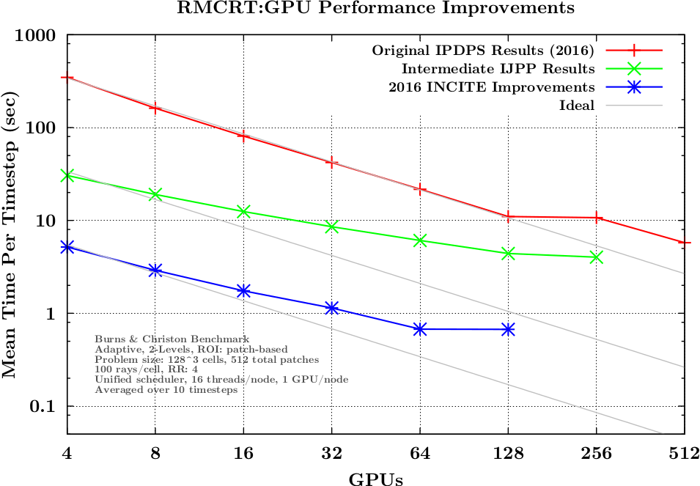
Uintah Improvements
Prior runtime enhancements have significantly reduced copy overhead.
Tasks do a much better job fully occupying a GPU.

Slide 16
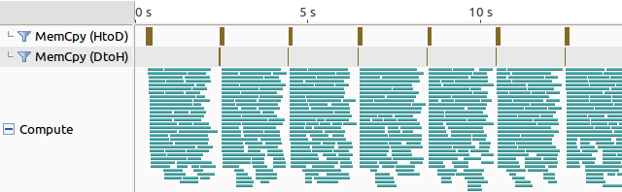
Splitting Tasks into Multiple Streams and Kernels
Problem: Tasks with larger patches are difficult to distribute among a GPU. But tasks with small patches add more runtime overhead.
Finer grained tasks aren’t always the answer!
Solution: A compromise is splitting tasks into multiple kernels, each launched on its own stream.
The runtime now supports managing multiple streams per task. Almost 100 streams shown below!
RMCRT GPU tasks using 300 rays in a 28x28x56 cell domain in 16 patches - 8 CPU threads, 6 streams per kernel on a Nvidia K20c GPU

Slide 17
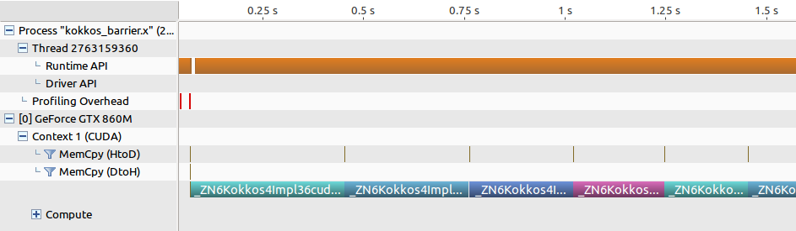
Kokkos for GPUs
Kokkos’s goals:
Compiles and runs on multiple architectures
Obtains performant memory access patterns via architecture-aware arrays and work mapping
Can leverage architecture-speciﬁc features where possible.
Kokkos::parallel_for ( Kokkos::RangePolicy<Kokkos::Cuda>(0,256), my_functor());
Problem: Kokkos is bulk synchronous on the GPU! All copies and kernels synchronize.
Notes:
The functor is the heart of Kokkos

Slide 18
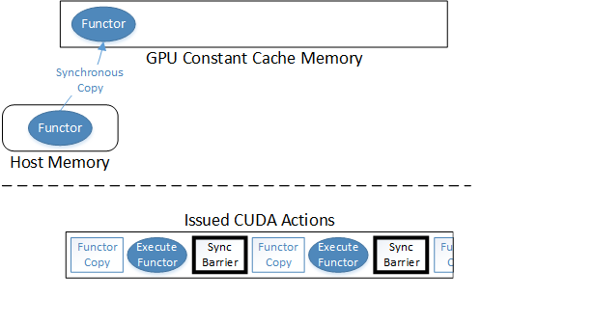
Kokkos Functors and GPUs
Functors are the heart of Kokkos code portability.
RAJA, Nvidia Thrust, Hemi-2 use functors as well for GPUs
For GPUs, if the functor is large, Kokkos places the functor is placed into GPU Constant Cache Memory.
GPU Constant Cache Memory acts as read-only registers.
Kokkos executes the functor inside a kernel.

Slide 19
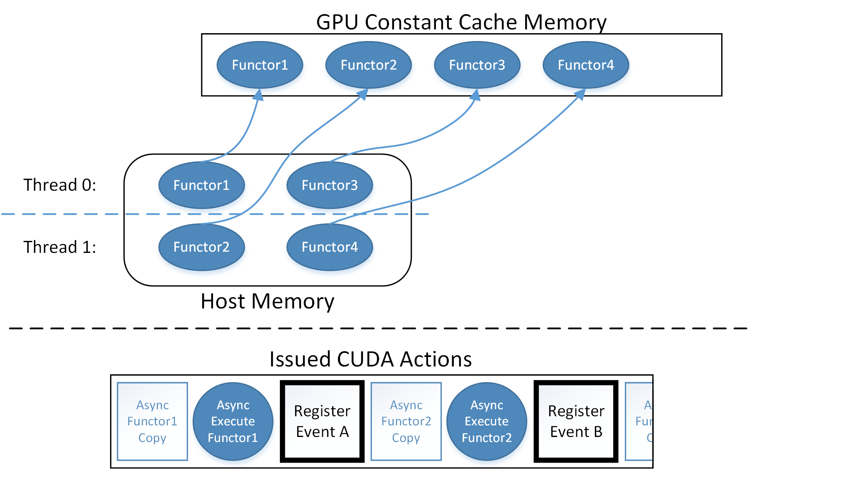
Modifying Kokkos for Multiple Asynchronous Functors
I implemented a lock free allocation bitmap for functors.
If the bitmap is full of functors, Kokkos checks all CUDA events to see if a prior functor completed, then can free that constant cache space.
Notes:
CUDA streams not shown yet…

Slide 20
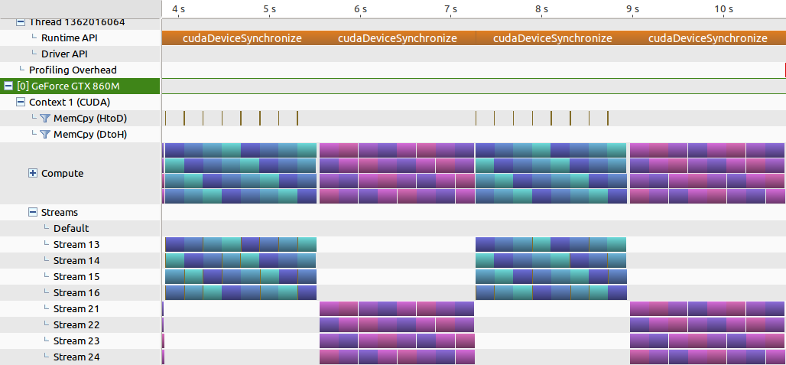
Current Kokkos Results
Blue is Kokkos::parallel_for loops using Kokkos Cuda Instances.
Purple is CUDA code using CUDA streams (both code sets use same logic).
Both are executing on 4 streams and 4 different kernels/functors.

Slide 21
Kokkos - GPU Parallel Reduce
Much more going on under-the-hood compared to a Kokkos::parallel_for.
Biggest asynchrony issue: The reduction value
Pinned memory for GPU-to-host copy is crucial (Kokkos can be modified to automatically manage this.)
RAJA and OpenACC synchronize when copying the reduction result into host memory.
Work is 60-75% complete.

Slide 22
Future Work – Data Management Performance
OnDemand Data Warehouse’s halo gathering makes duplicates of variables.
Derek Harris is currently having big problems with this.
Should use GPU Data Warehouse model for simulation variable:
Sharing among tasks
Pre-sizing
Pre-allocating
GPU Data Warehouse gathers in halo cells through GPU kernels.
Both James Sutherland and I have noticed this is not as fast as we want.

Slide 23
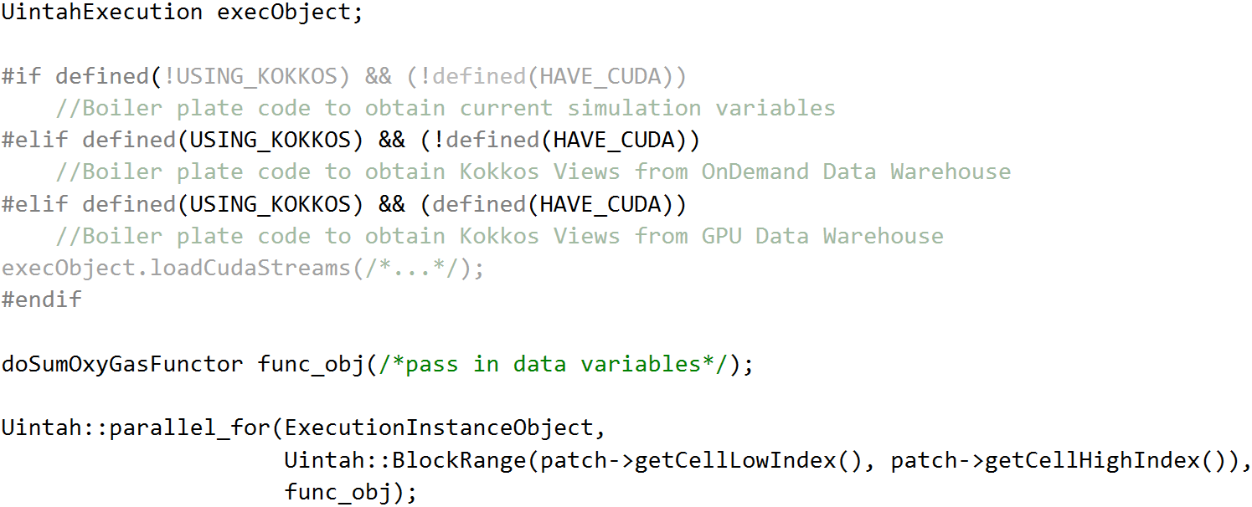
Future Work – Data Management Portability
Currently, ugly and non-portable preprocessor directives needed to retrieve simulation variables.
Goal: Application developers shouldn’t have to do this!

Slide 24
Future work – Defining Completion of Work
Focus on tasks written with Kokkos code.
RMCRT and Arches tasks are the target problems.
Will not rewrite existing CPU tasks into Kokkos.
Demonstrate production ready tasks that:
Use one functor codebase that can run on CPUs and GPUs (and possibly demonstrate on Xeon Phi KNLs).
Require minimal to zero architecture specific code stubs for application developers.
Retrieve simulation variables in a portable way (one set of code only).
Compute with comparable times as existing CPU and GPU task implementations.
Avoids synchronization (Uintah is an AMT after all).
Note: Some tasks can’t port if they depart from Uintah conventions or use non-portable code (e.g. STL containers, system calls, etc.)

Slide 25
Questions?

Slide 26
Future work - Example of Kokkos GPU Integration
Application developer would add the object in red (supplied by the runtime).
The runtime can ensure GPU, CPU, or Xeon Phi for the rest.
CCVariable<double> oxiSrc;
new_dw->allocateAndPut( oxiSrc, _src_label, matlIndex, patch );
constCCVariable<double> qn_gas_oxi;
new_dw->get( qn_gas_oxi, gasModelLabel, matlIndex, patch, gn, 0 );
Uintah::BlockRange range(patch->getCellLowIndex(),patch->getCellHighIndex());
sumCharOxyGasSource doSumOxyGasFunctor(qn_gas_oxi.getKokkosView(), oxiSrc.getKokkosView());
Uintah::parallel_for(ExecutionInstanceObject, range, doSumOxyGasFunctor);

Slide 27
Future Work - Task Scheduler Modifications
OnDemand Data Warehouse currently allocates variables on-the-fly during task execution.
Need to adopt GPU Data Warehouse model where allocations occur prior.
This will enable data sharing for the OnDemand Data Warehouse.
Support modifies variables. (Effectively like a compute).

Slide 28
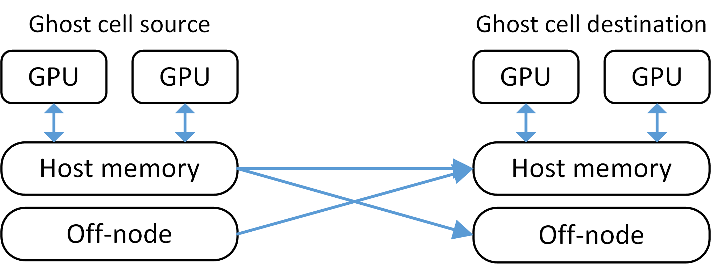
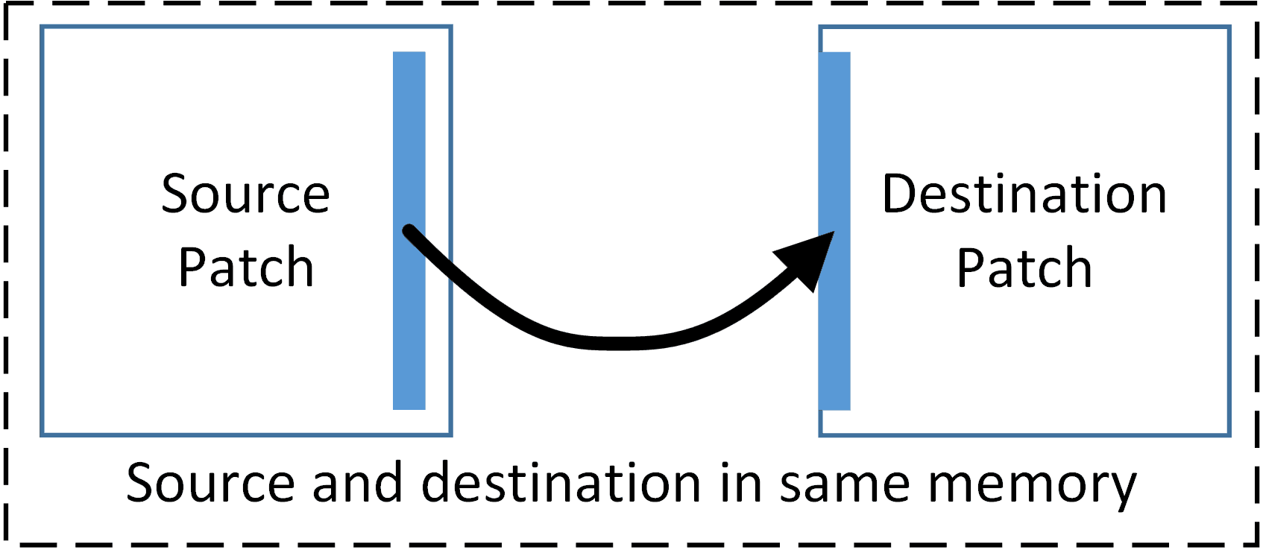
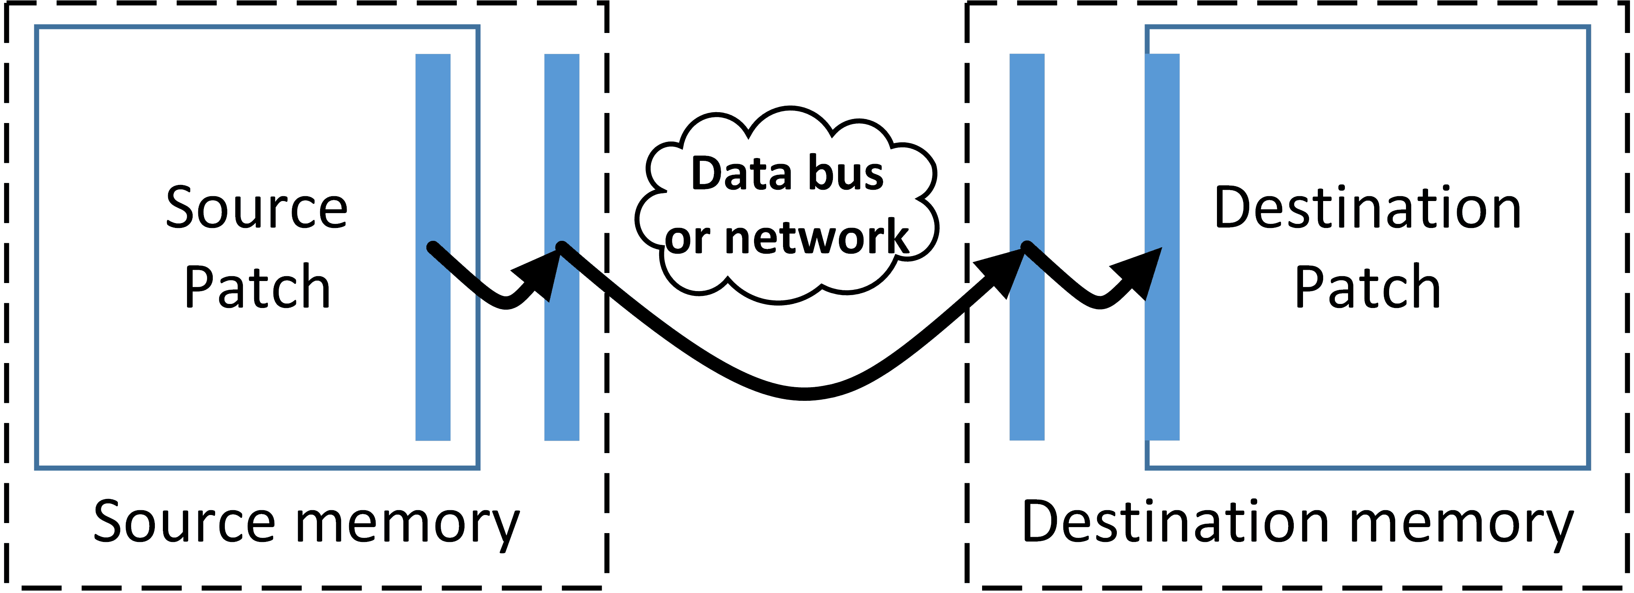
Halo Gathers in GPU memory
Before, all halo gathers happened in host memory
Copying changed so halos can copy within the same memory region
Halo buffers also sent into GPU memory if simulation variable resides there.

Slide 29
Defining Portable
Kokkos
Run Kokkos enabled tasks on GPUs, CPUs, and Xeon Phis with minimal architecture specific requirements in task code.
Task API
Preserve application layer API with minimal GPU runtime interaction.
Data Warehouse API
Keep data warehouse logic uniform for host and GPU memory.

Slide 30
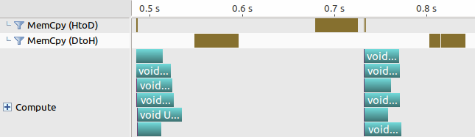
Defining Performant
Low wall time overhead (in milliseconds) for task preparation.
Lower memory usage due to data sharing.
Similar Kokkos and non-Kokkos tasks execution wall times should be comparable.
Note: Kokkos can’t force performant code, and users can still write slow code!
Before:
After:
Before:
After:

Slide 31
Future Work - Complete Kokkos Modifications
Complete Kokkos::parallel_reduce modifications for asynchrony.
Mostly polishing and minor features.
Investigate register usage restriction.
CUDA has had it for years.
We used it for big performance gains on last year’s Titan runs.
Kokkos just introduced a feature to support this.

